Slide 1

How to connect my GPS file with Tableau?
Process & Tools Team

Slide 2
1
Open your GPS File
2
Programs, Users groups and OTTO
3
Send data (Version 8.1)
4
Send data (Version 9)

Slide 3
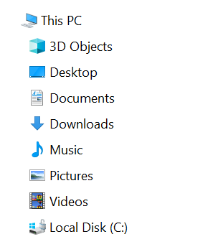
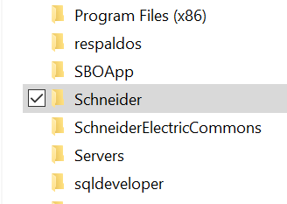
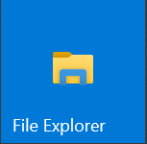

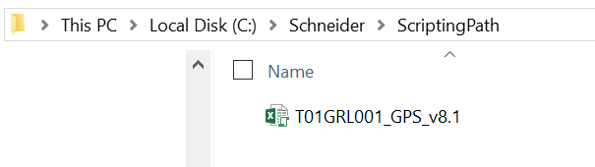
Open your GPS
For security, CylancePROTECT will detect and block Microsoft Office macros execution(If a script refers to data outside the document). Please follow the next steps to send data to Tableau.
Open your GPS file in the next path (C:\Schneider\ScriptingPath):
Notes:
This is an example of a Text Slide. Reference the different layout options in the Slide Master (under the View tab) for different variations. Remember, our new Brand Guidelines call for clean and simple messages and design. Reference the PowerPoint Guidelines on the Brand Book for tips and useful information on creating effective presentations.

Slide 4
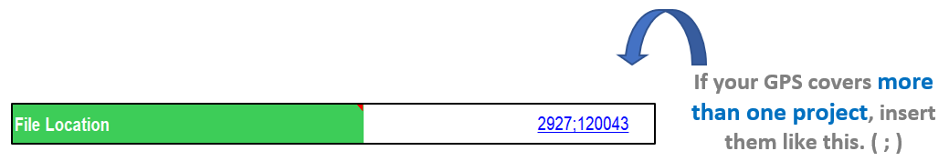
Programs, Users groups & OTTO
In order to improve the classification of our Dashboard initiatives it’s necessary to fill in Program, user group and File location lines as the example:
Programs:
COS-Outsourcing
Rebalancing-SBO
QVE Power Systems & Power Products
QVE H&D
QVE DE, SP, and IA
COS Ideas
QVE Ideas
User group:
NAM Procurement

Slide 5
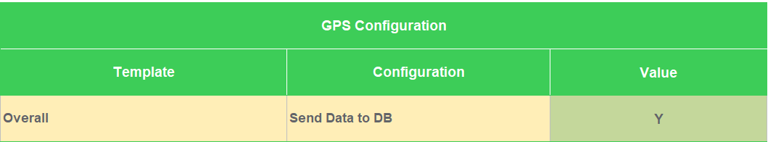
Share data (Version 8.1)
*Note: Changes will be reflected the next day
If you are ready to send data to Tableau, please follow the next steps.
Open your GPS file.
Active “Send data to DB” in General Settings sheet.
Charter sheet put Public in Access cell.

Slide 6
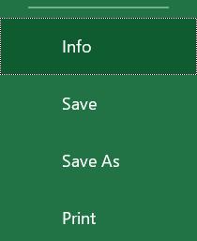

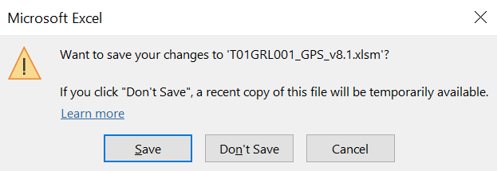
Share data (Version 8.1)
*Note: Changes will be reflected the next day
4. Add a new Initiative ID #:
5. Save the changes.
a)
b)
c)

Slide 7
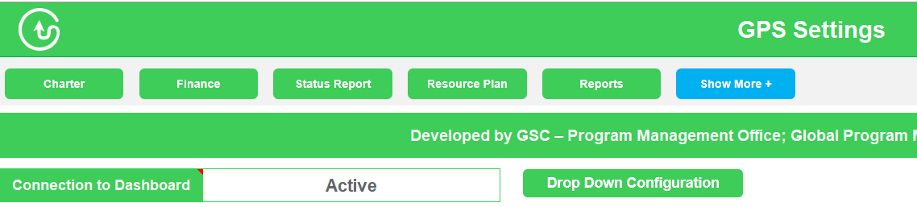
Share data (Version 9)
*Note: Changes will be reflected the next day
If you are ready to send data to Tableau, please follow the next steps.
Open your GPS file.
Active “Connection to Dashboard” in General Settings sheet.
Light GPS or Charter sheet put “Public” in Public / Restricted cell.

Slide 8
Share data (Version 9)
*Note: Changes will be reflected the next day
4. Add a new Initiative ID #
5. Save the changes.
a)
b)
c)

Slide 9
Notes:
Closing slide

